Slide 1
LEGO PROJECT
Team members:
Riya Agarwal
Reshini Suresh Kumar
Kalpesh Balkrushna Patil
Balbir Singh

Slide 2
OBJECTIVE
Design and construct an efficient, cost-effective racing car that maximizes the distance. Utilize Design of Experiments (DOE) to evaluate and optimize the factors affecting the car’s performance, ensuring a balance between performance and material cost.

Slide 3

EXPERIMENTAL SETUP
Experiment was conducted in a closed team room in McCord Hall.
A sturdy cardboard notepad served as the base material for our ramp. We mounted it between two metal mesh desk organizers for stability.
Measured the distance traveled in cm (response variable) by the car from the end of the ramp to the front of the car electronically using a phone.

Slide 4
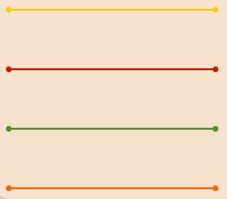
FACTORS
Wheel size
Small, Big
Length
Short, long
Weight
No extra Weight and Weight
Design
Narrow, Wide

Slide 5
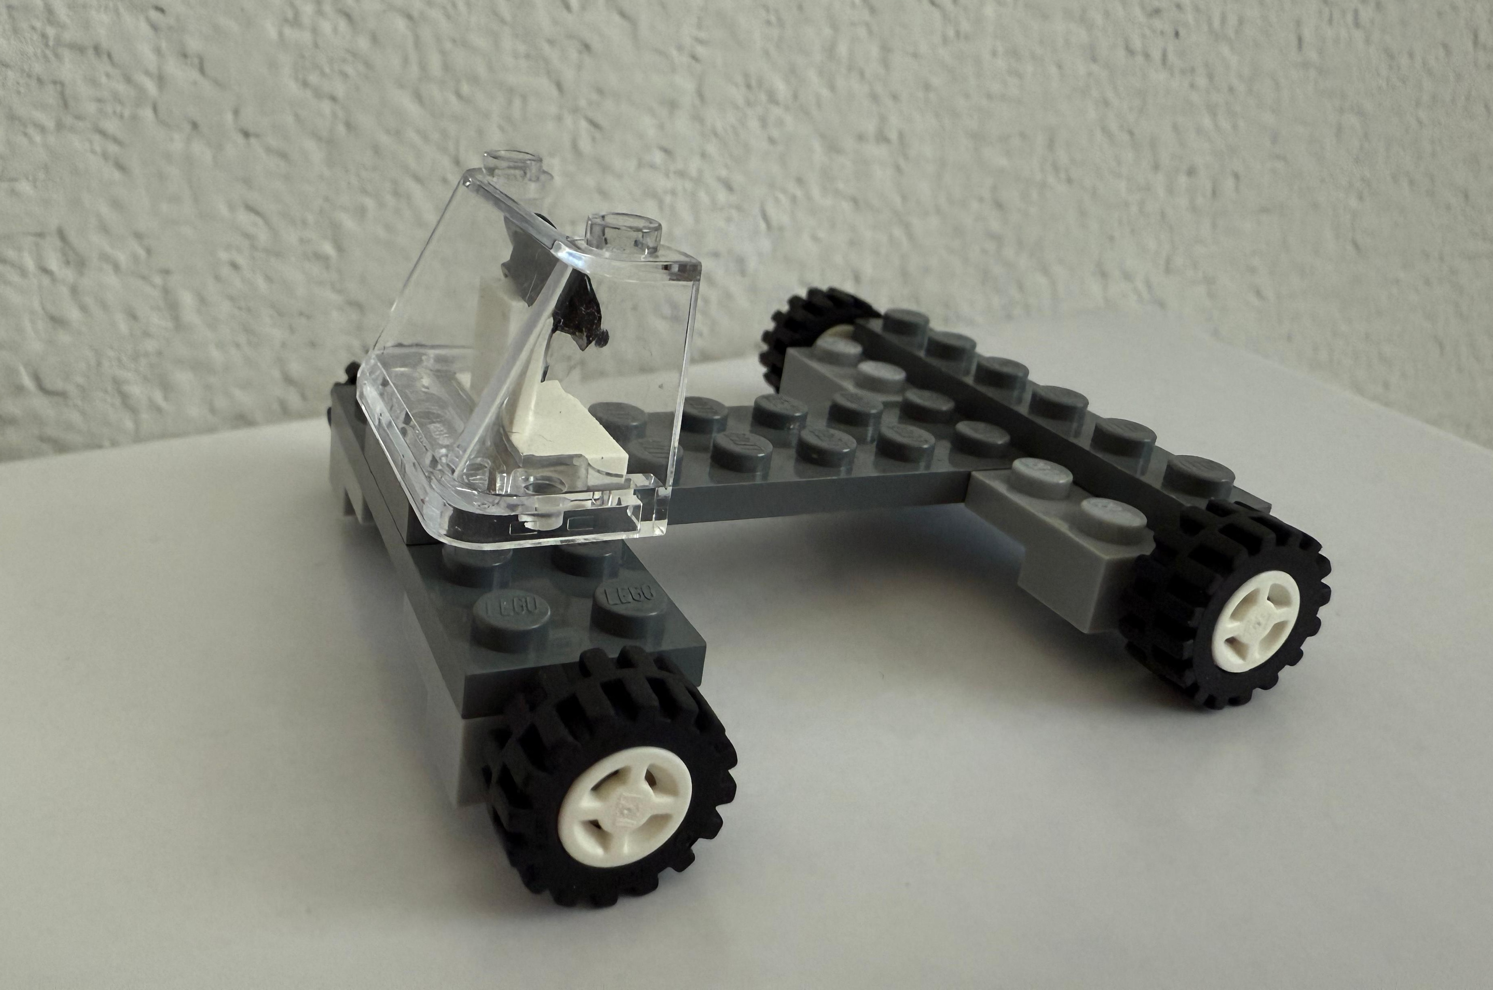
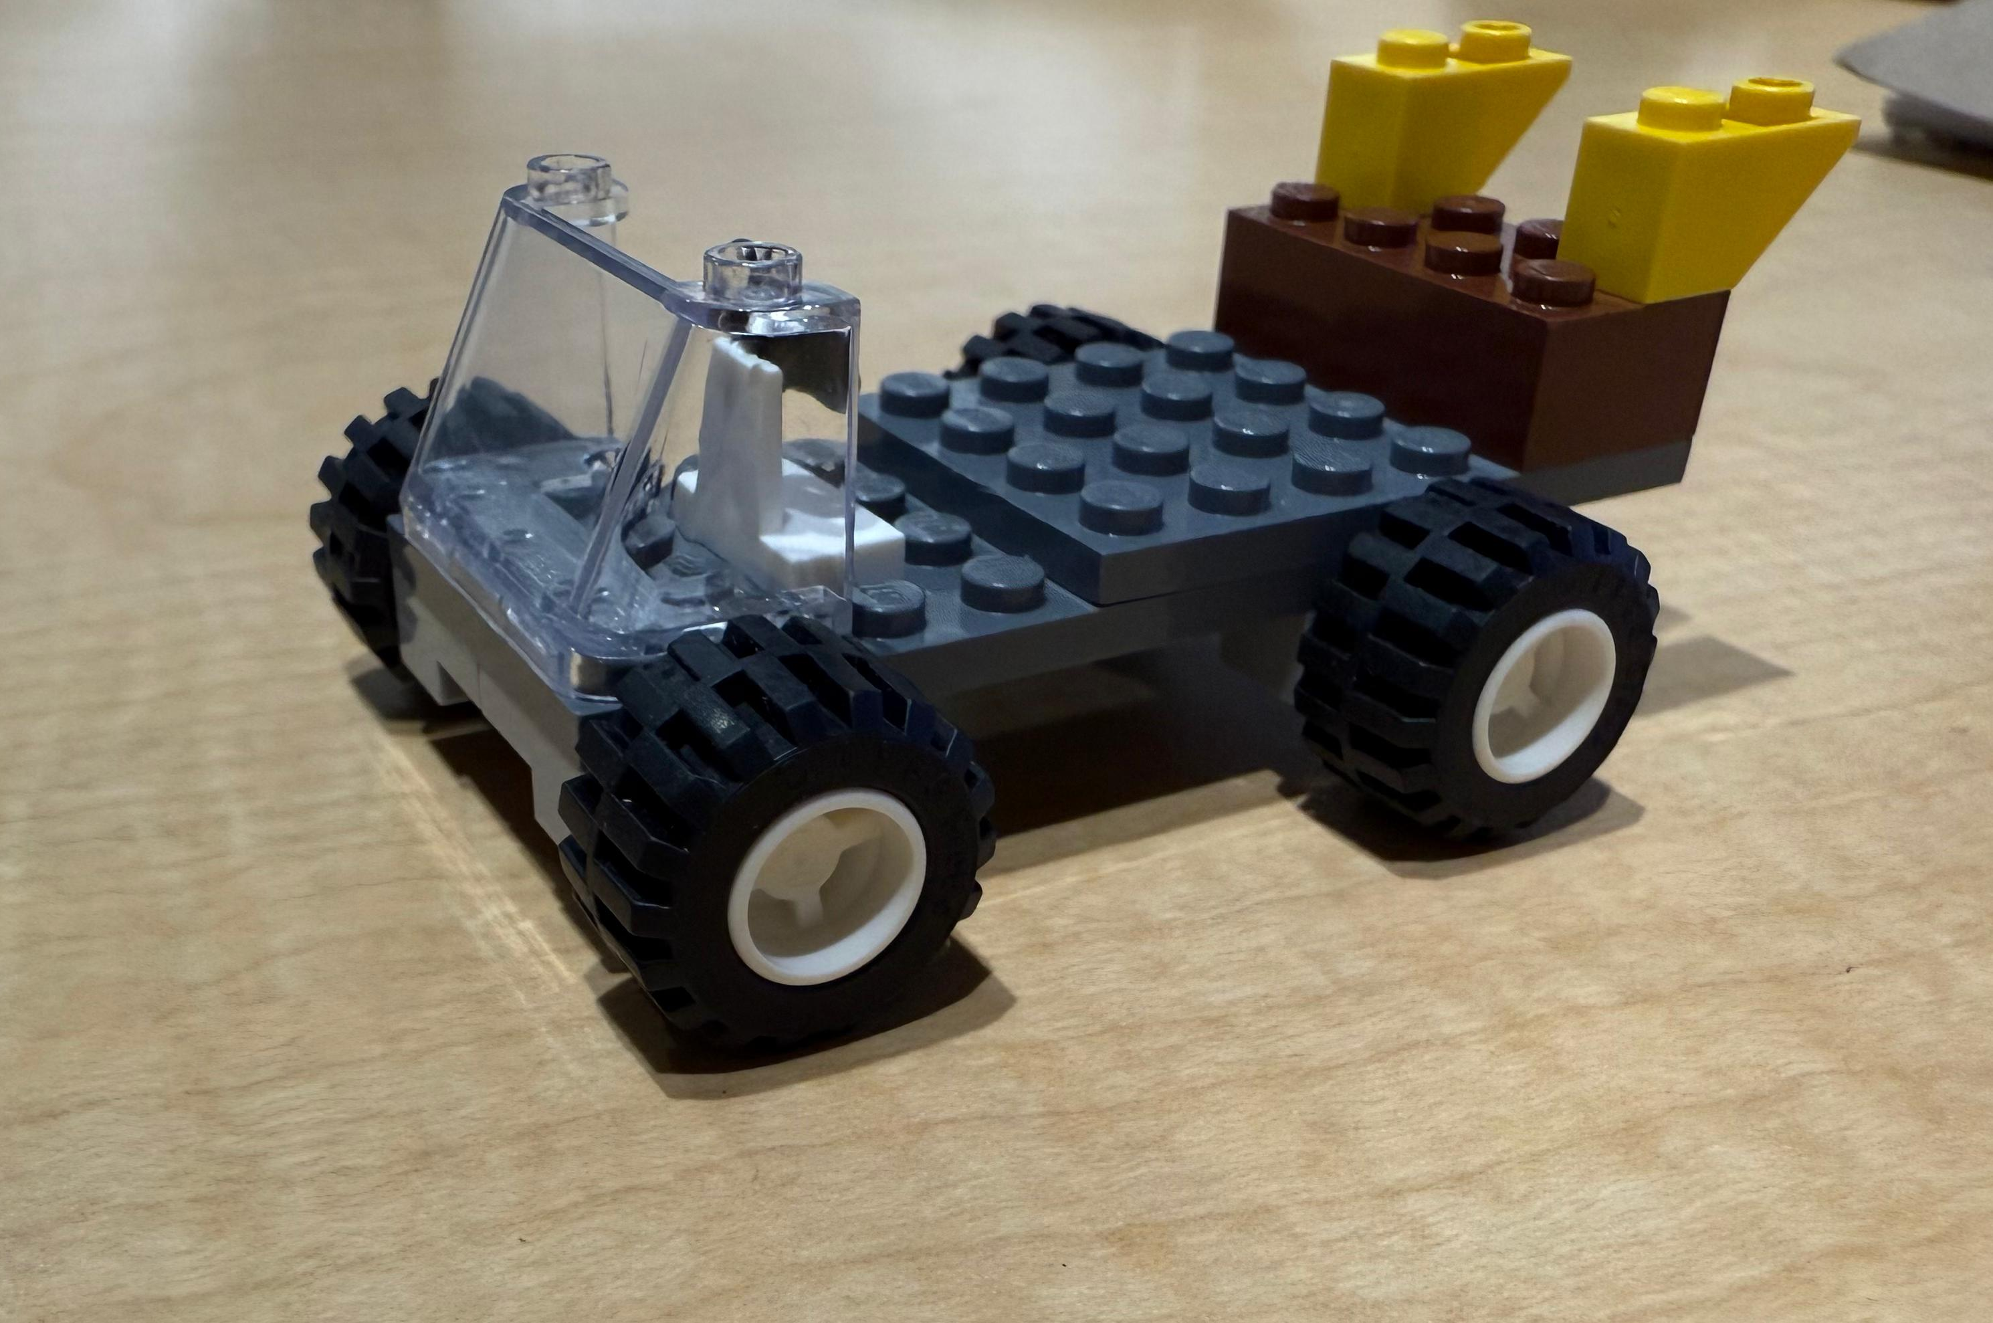
CAR MODELS
All factors at low:
Small Wheels,
Narrow Design,
No Extra Weight,
Short length.
All factors at high:
Big Wheels,
Wide Design,
Extra Weight added,
Long length.

Slide 6
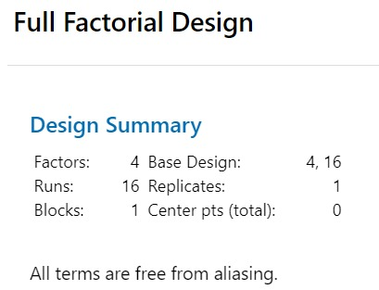
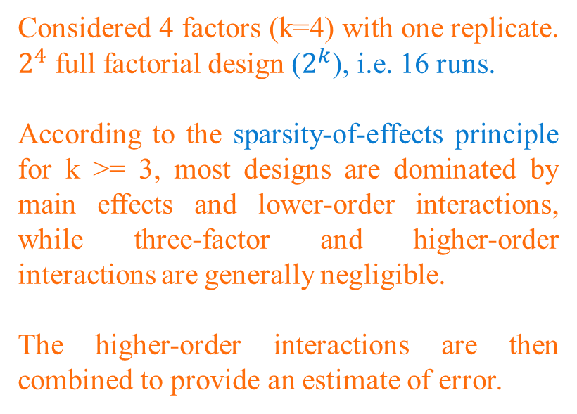
EXPERIMENTAL APPROACH
Considered 4 factors (k=4) with one replicate. $2^{4}$ full factorial design ($2^{k}$), i.e. 16 runs.
According to the sparsity-of-effects principle for k >= 3, most designs are dominated by main effects and lower-order interactions, while three-factor and higher-order interactions are generally negligible.
The higher-order interactions are then combined to provide an estimate of error.

Slide 7
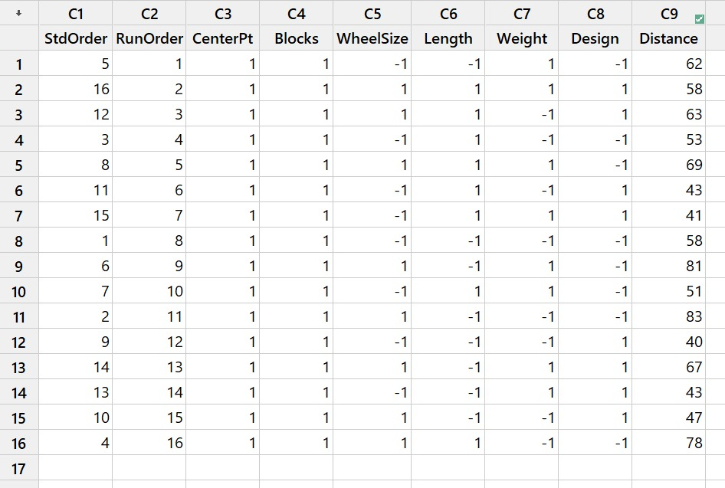
EXPERIMENT DESIGN
.
4 factors – 1 replicate – 16 runs were conducted.
To block any noise from external factors – we performed the experiment in a random order (RunOrder) generated by Minitab.
Ensured one person was releasing the car on the ramp from the same location.
All runs were conducted in a controlled environment - on the same day in the same room without moving the ramp.

Slide 8
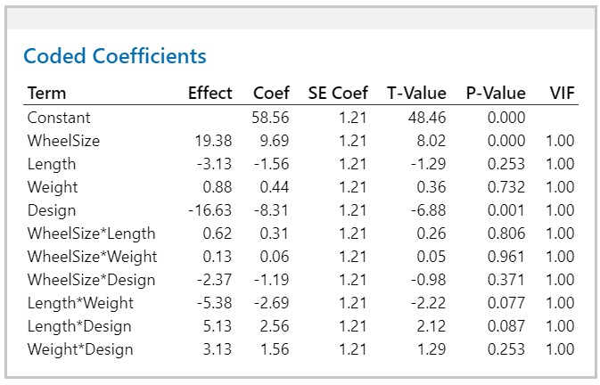
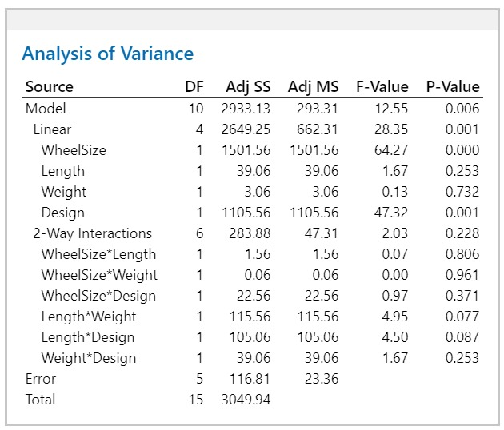
CODED COEFFICIENTS & ANOVA OF INITIAL MODEL
To find significant factors, we have performed initial analysis for main effects and lower order interactions.
The P-value of WheelSize and Design is less than 0.05, hence we reject the null-hypothesis. This means that they are the significant factors in increasing the distance traveled by the car.

Slide 9
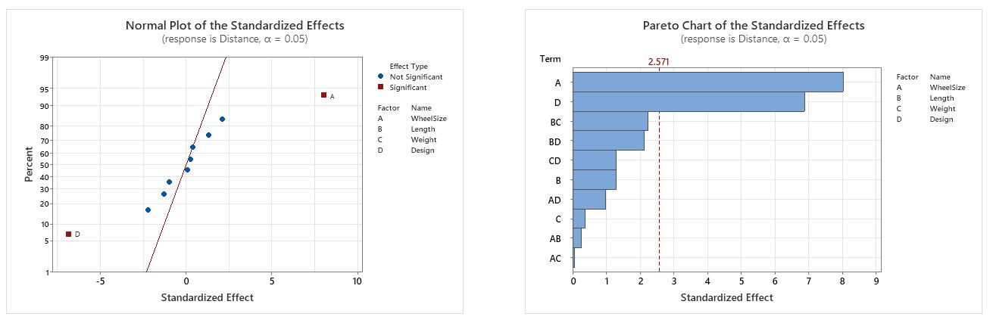
SIGNIFICANT FACTORS
The factors A and D are significant. This confirms the ANOVA analysis through Normal plot and
Pareto chart.

Slide 10
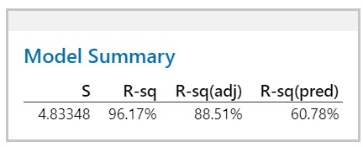
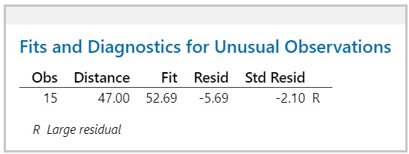
MODEL SUMMARY OF INITIAL MODEL
The R-sq(pred) is only 60.78% for the initial model. This assesses the model's ability to predict new observations.
There is an unusual observation, and it needs to be examined to understand what might have caused it.

Slide 11
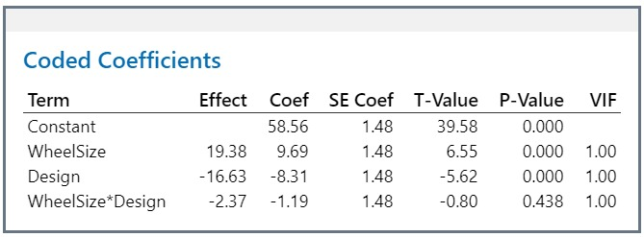
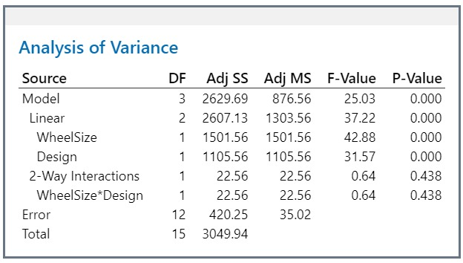
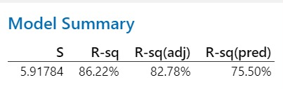
REFINED MODEL
ANOVA analysis done for A, D and AD (considering the hierarchy). This is the final refined model.
The R-sq(pred) is increased to 75.50%. Thereby, improving the model's ability to predict new observations.

Slide 12
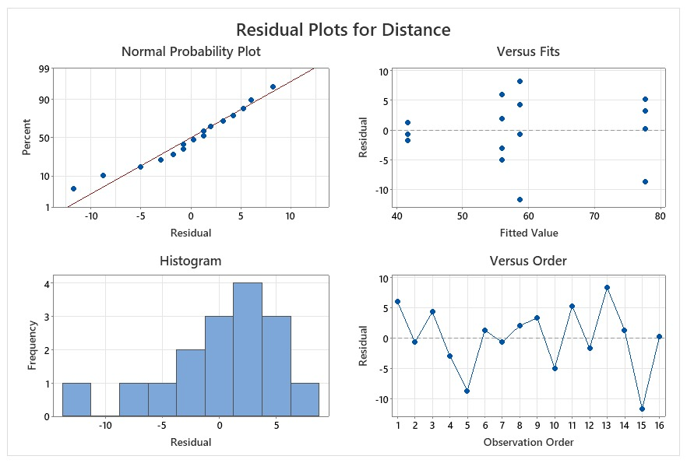
MODEL ADEQUACY CHECK
Normality plot: Almost fits a fat pencil test - except the bottom 2 residuals, all the points are normally distributed.
Versus Fit: There is a clear exhibition of the data distribution in almost equal variance.
Versus Order: There is no anomaly, the chart looks in-control and independent.
Histogram: Depicts a normal distribution.
Hence, NID Assumptions are satisfied.

Slide 13
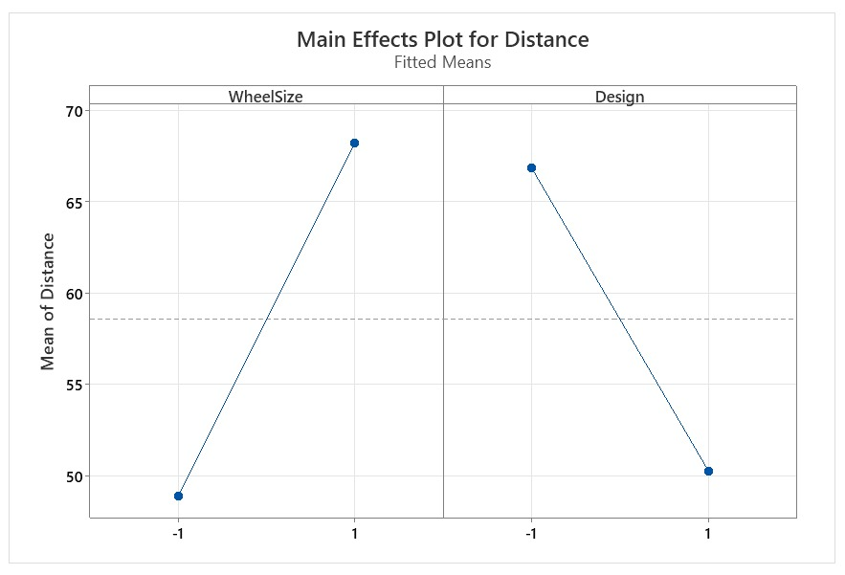
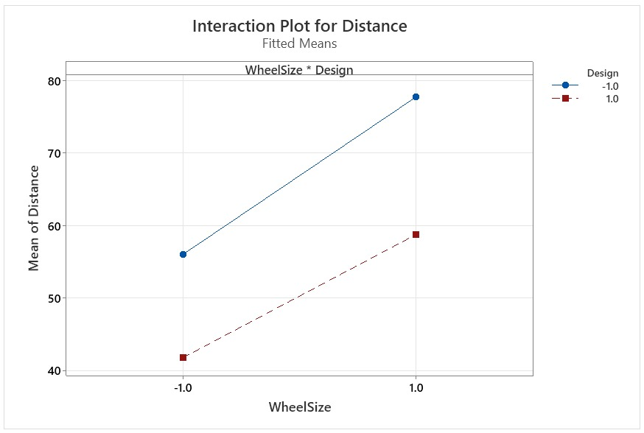
FACTORIAL PLOTS
Main Effects Plots:
Wheel Size = Big (+1)
Design = Narrow (-1)
This combination travels maximum distance.
Interaction plot:
Since the interaction factor is not significant – lines are almost parallel.
We still wanted to plot this due to hierarchy and see whether it would change anything. However, we observe the same conclusions as the main effects plot.

Slide 14
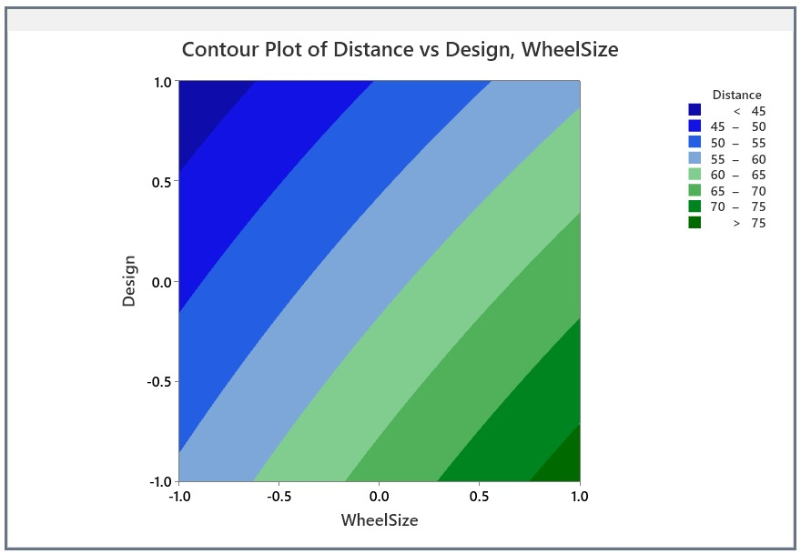
CONTOUR PLOT
The Contour plot shows that distance is maximum at the bottom right (darker shades of green) – This area corresponds to Wheel Size at +1 and Design at -1.
Moving towards the top left (darker shades of blue) the distance traveled keeps decreasing and these areas corresponds to Wheel Size -1 and Design +1.
The dark green color represents the best performing model.

Slide 15
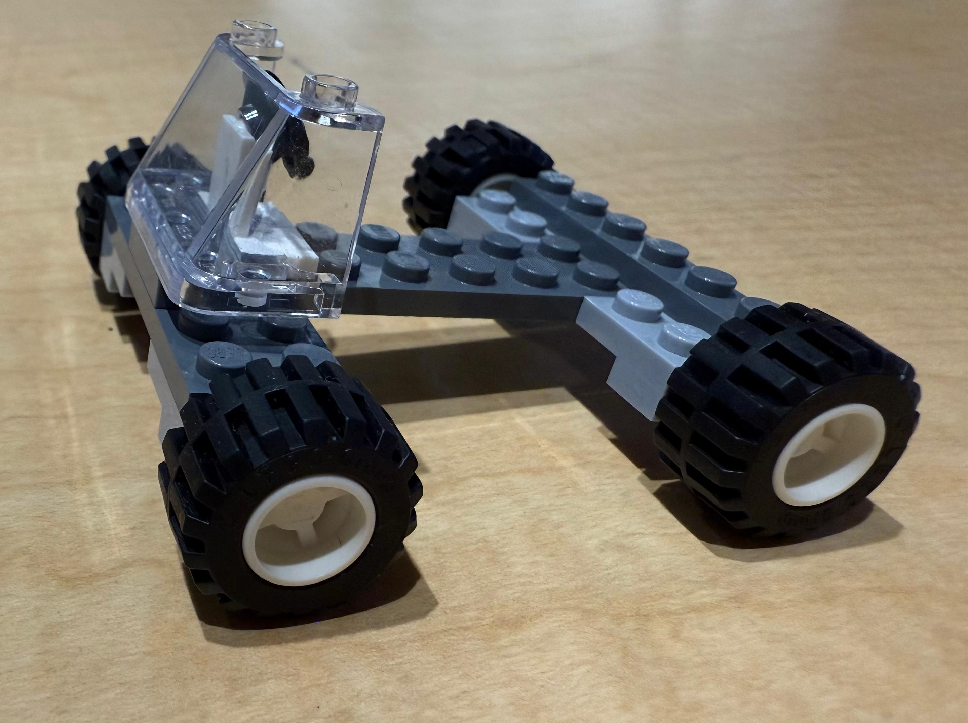
BEST MODEL
Wheel Size- Big (+1)
Design- Narrow (-1)
Length-Short (-1)
No weight added (-1)

Slide 16
FINANCIAL ANALYSIS
17100
Top 4 models
18800
Model 1
Wheel size: Big, Length: long, Weight: Weight Added, Design: Narrow
19600
20300
Model 2
Distance traveled
Wheel size: Big, Length: long, Weight: No Weight Added, Design: Narrow
Model 3
Wheel size: Big, Length: short, Weight: Weight Added, Design: Narrow
Model 4
Wheel size: Big, Length: Short, Weight: No Weight Added, Design: Narrow
The best performing car with least cost.
*The values above the bar chart are cost of the model in dollars

Slide 17
CONCLUSION
The optimal Lego car designed maximized distance traveled while balancing cost. Key factors like wheel type, base design significantly impacted performance.
Residual analysis validated the results, and a cost-effective design was identified.
Recommendations:
Optimal Design Configuration - Use a lightweight, low-center-of-gravity design with efficient wheels. We used a simple car design with no extra overheads for the best car.
2. Cost efficiency - Avoid high-cost components with minimal performance gains; opt for mid-range, cost-effective options. We used blocks which cost less by substituting similar pieces which were more cost effective.
This approach balanced performance and cost, ensuring a competitive, efficient design.

Slide 18
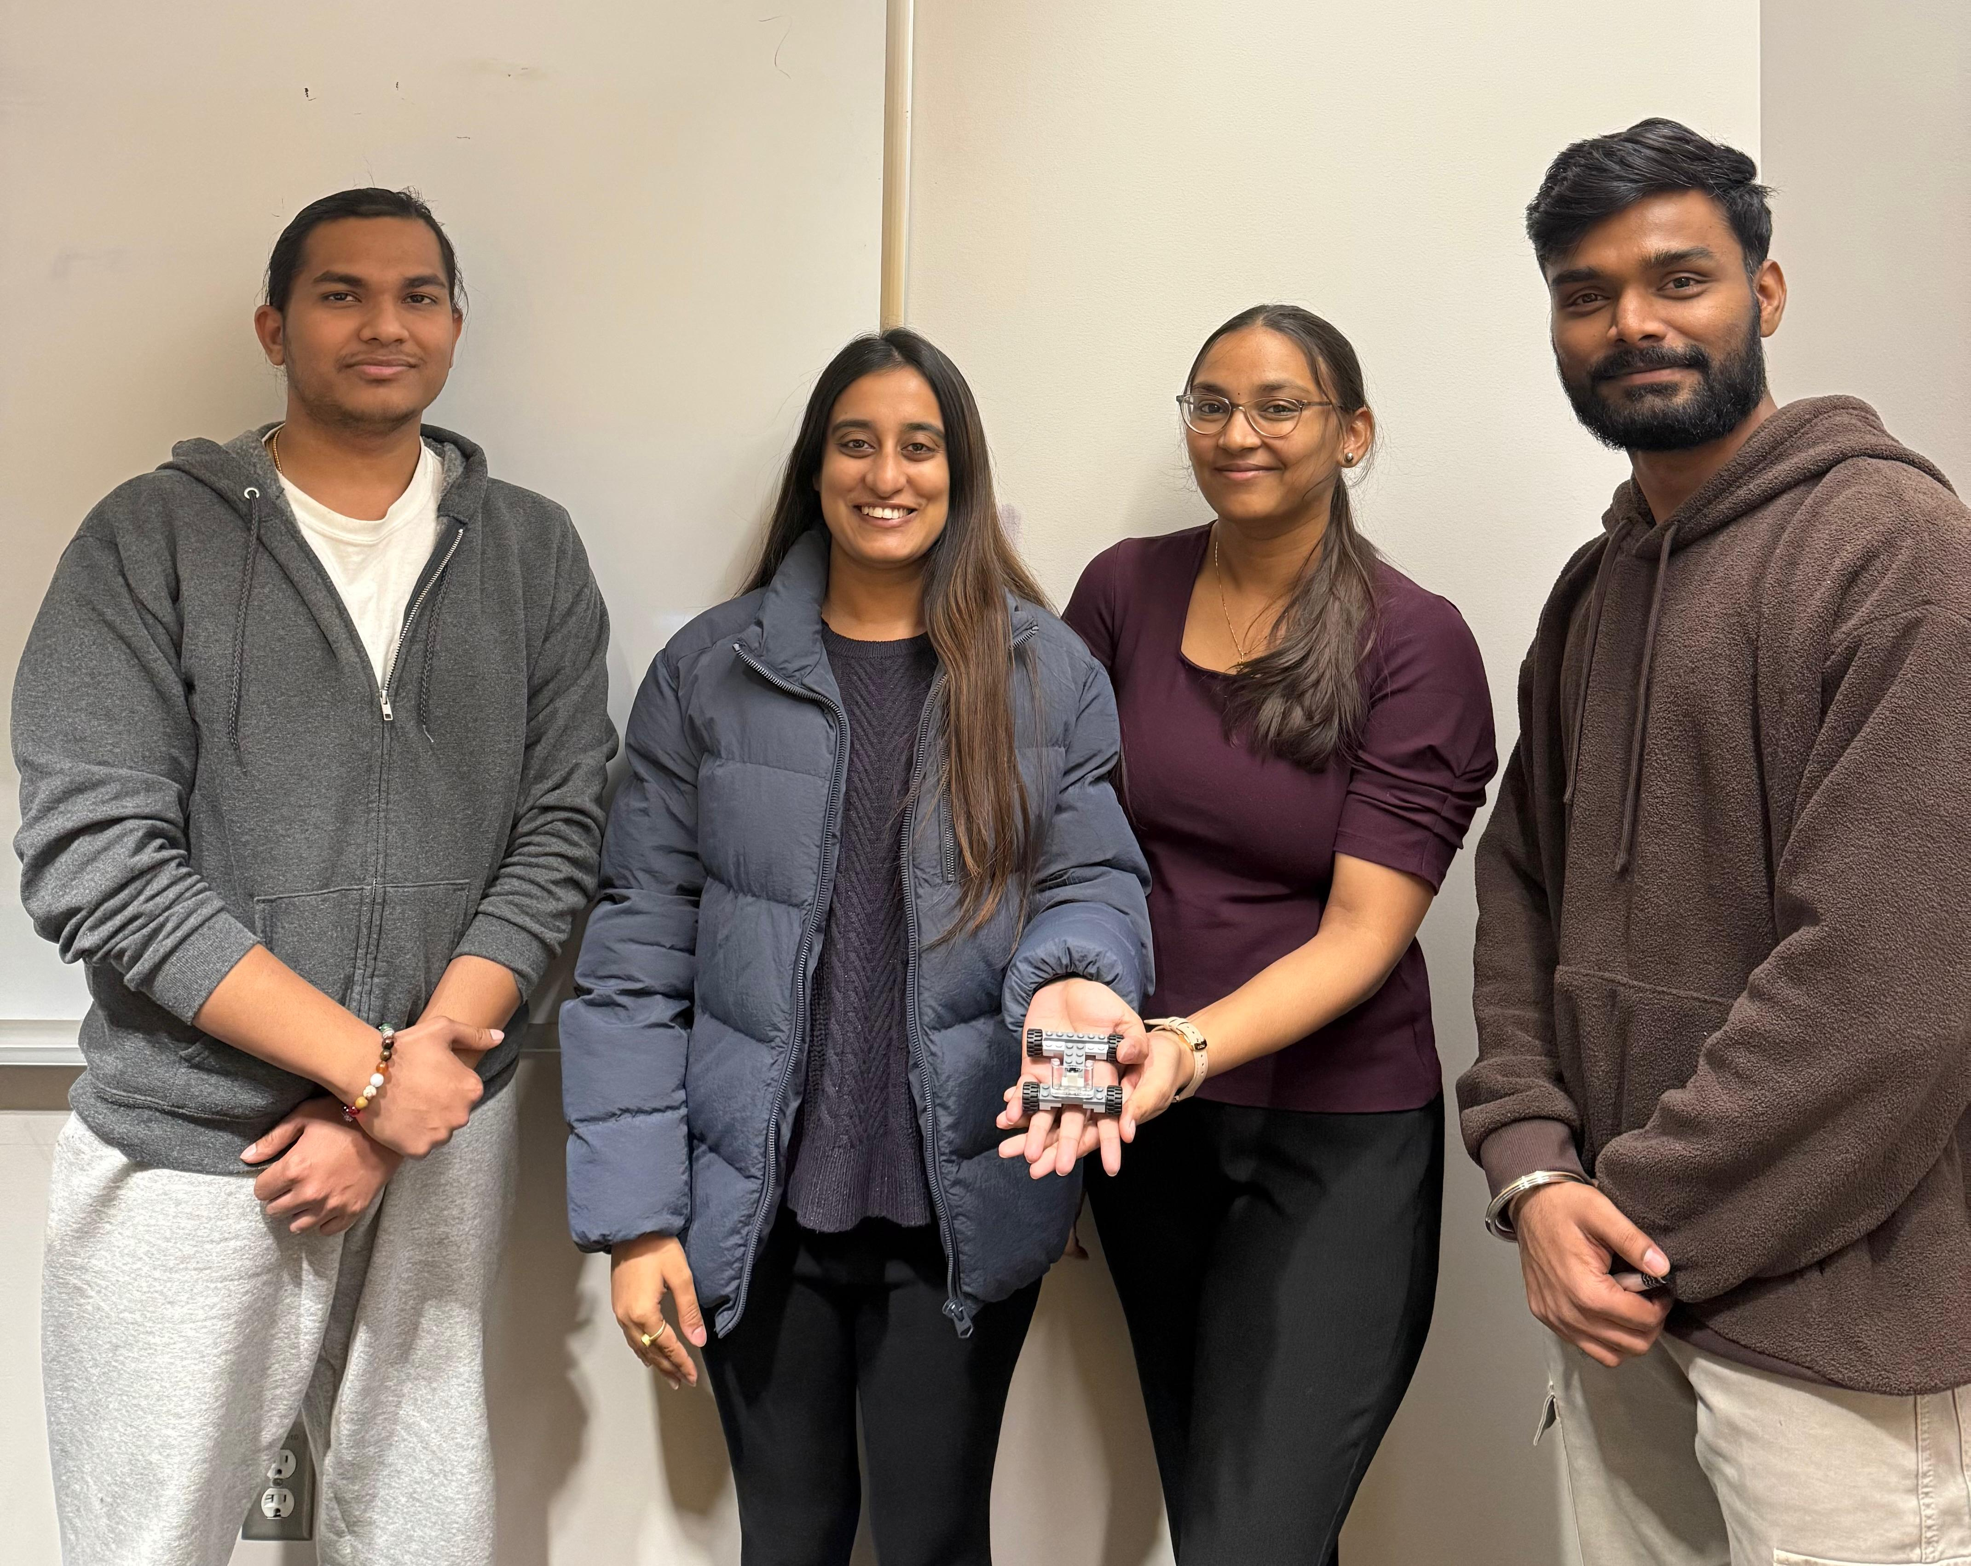
Thank You!

